Slide 1
Smart Meeting System to Control Attendances in Events
Smart Team:
Caique Bispo Ferreira
Scarbourogh, September 2019

Slide 2
Smart Meeting System to Control Attendences in Events
The purpose of SDD document and its intended audience
Architecture Context Diagram
Container Diagram
Component Diagram
Class Diagram (Model)
Class Diagram (Controlller)
Class Diagram Overview
Sequence Diagrams (Components)
Sequence Diagrams (Messages)
ER Diagram
Conclusion
Q & A

Slide 3
The purpose of SDD document and its intended audience
provides overall guidance to the architecture of this project
describes design goals and considerations
provides different levels of abstraction
consists of a hierarchical set of software architecture diagrams for context, containers, components, and code
Can be shared with the stakeholders whose the approval is needed.

Slide 4
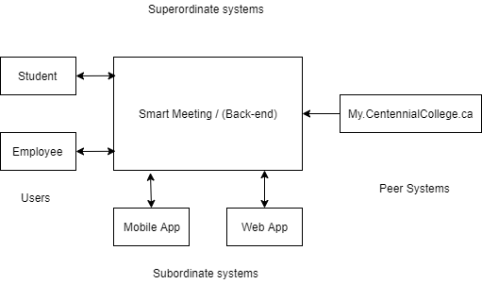
Architecture Context Diagram

Slide 5
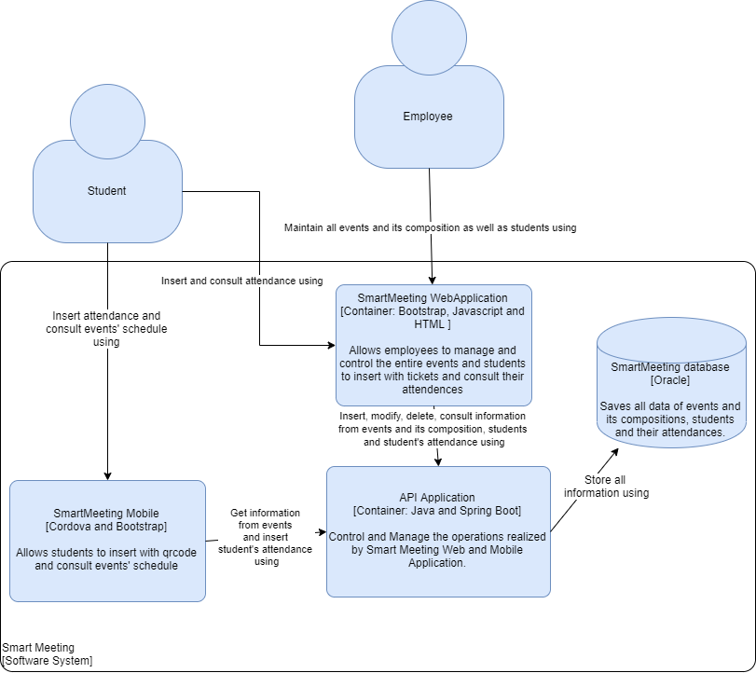
Container Diagram

Slide 6
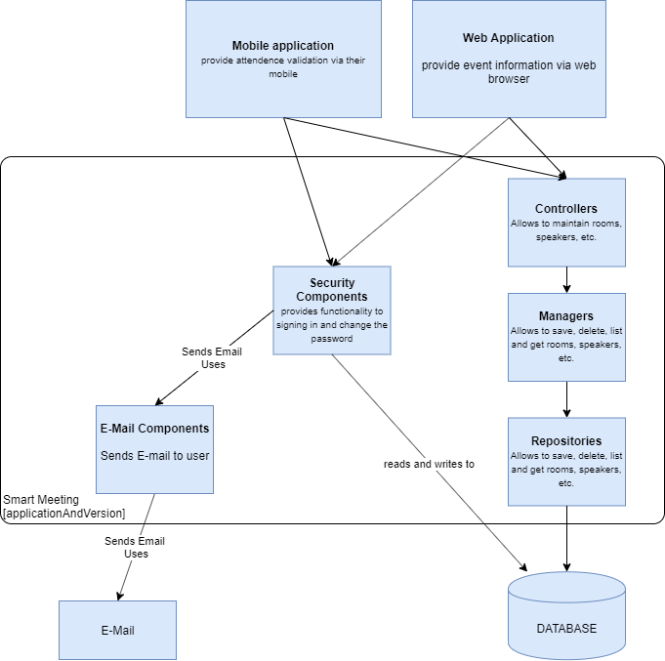
Component Diagram

Slide 7
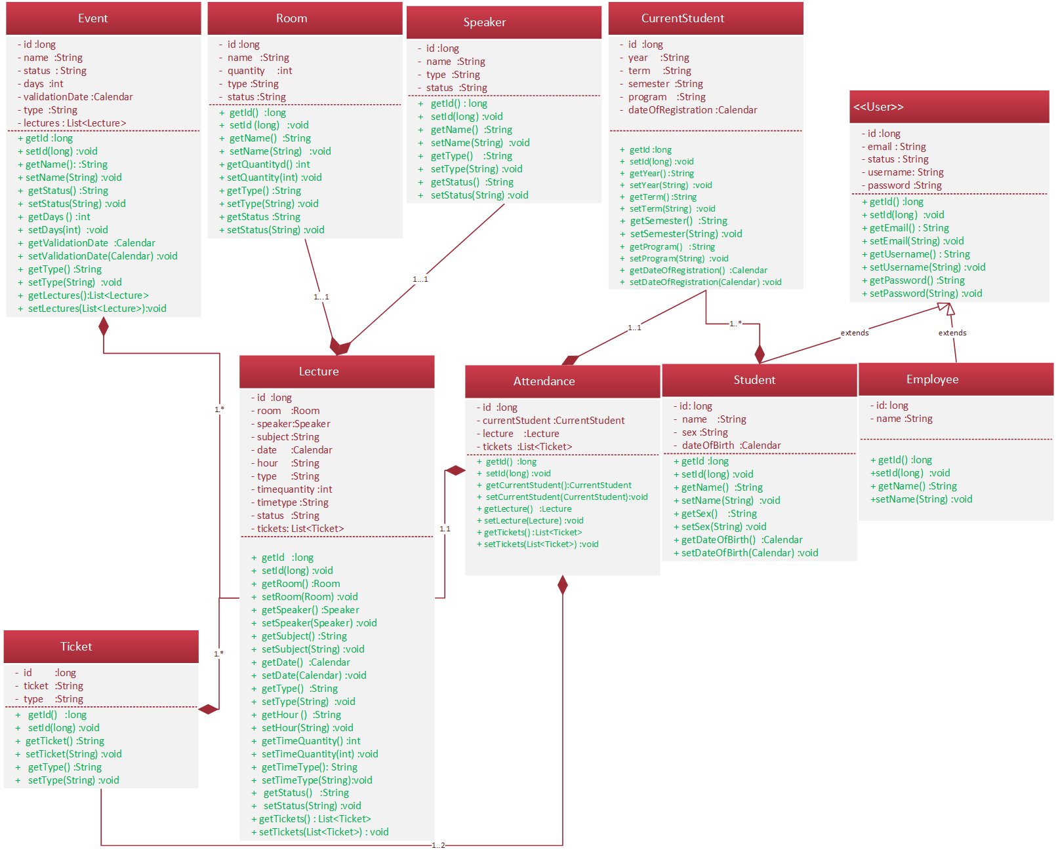
Class Diagram (Model)

Slide 8
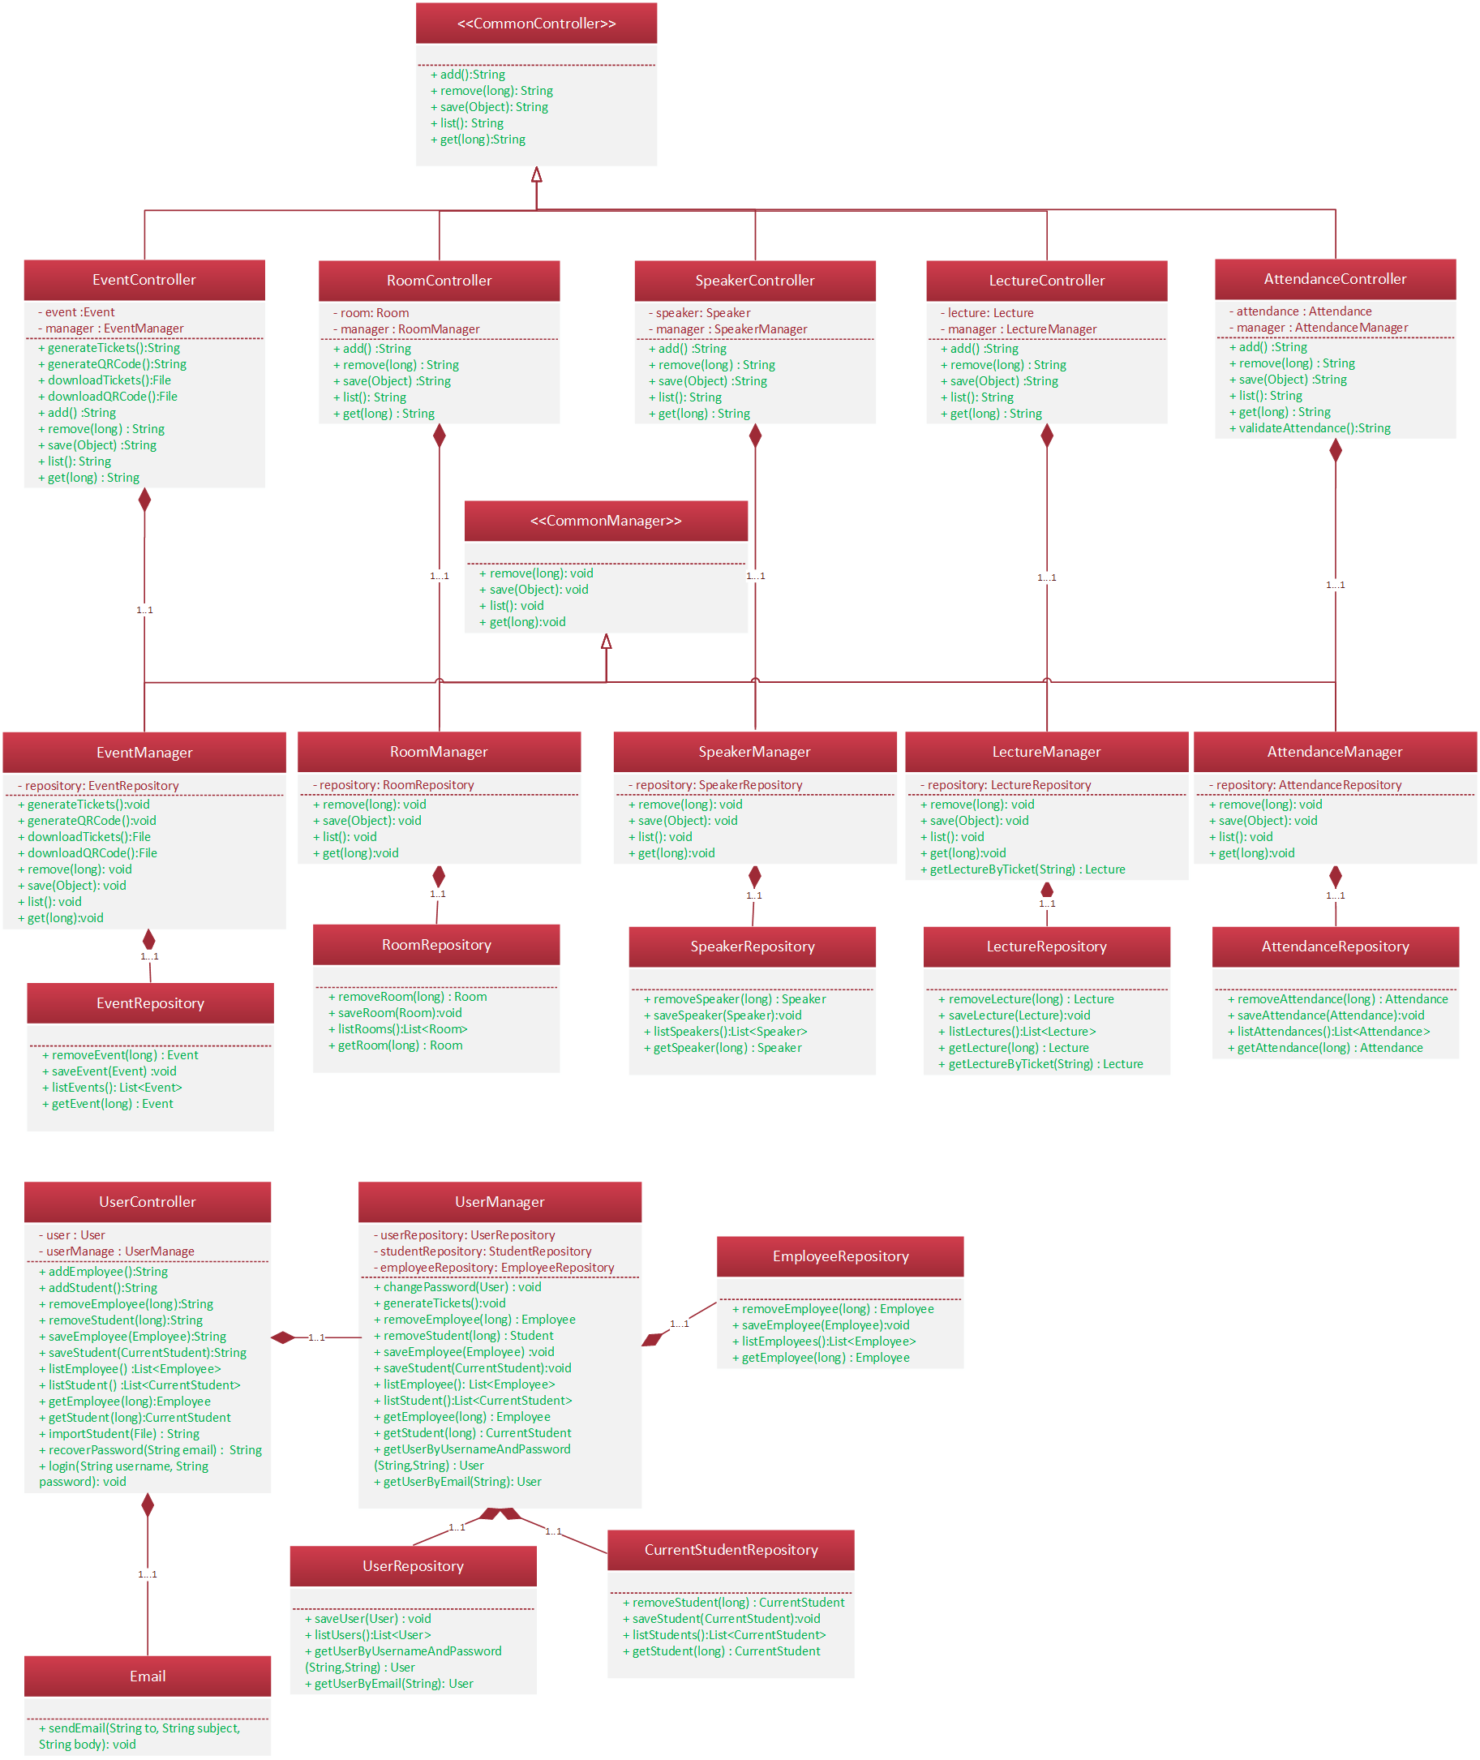
Class Diagram (Controller)

Slide 9
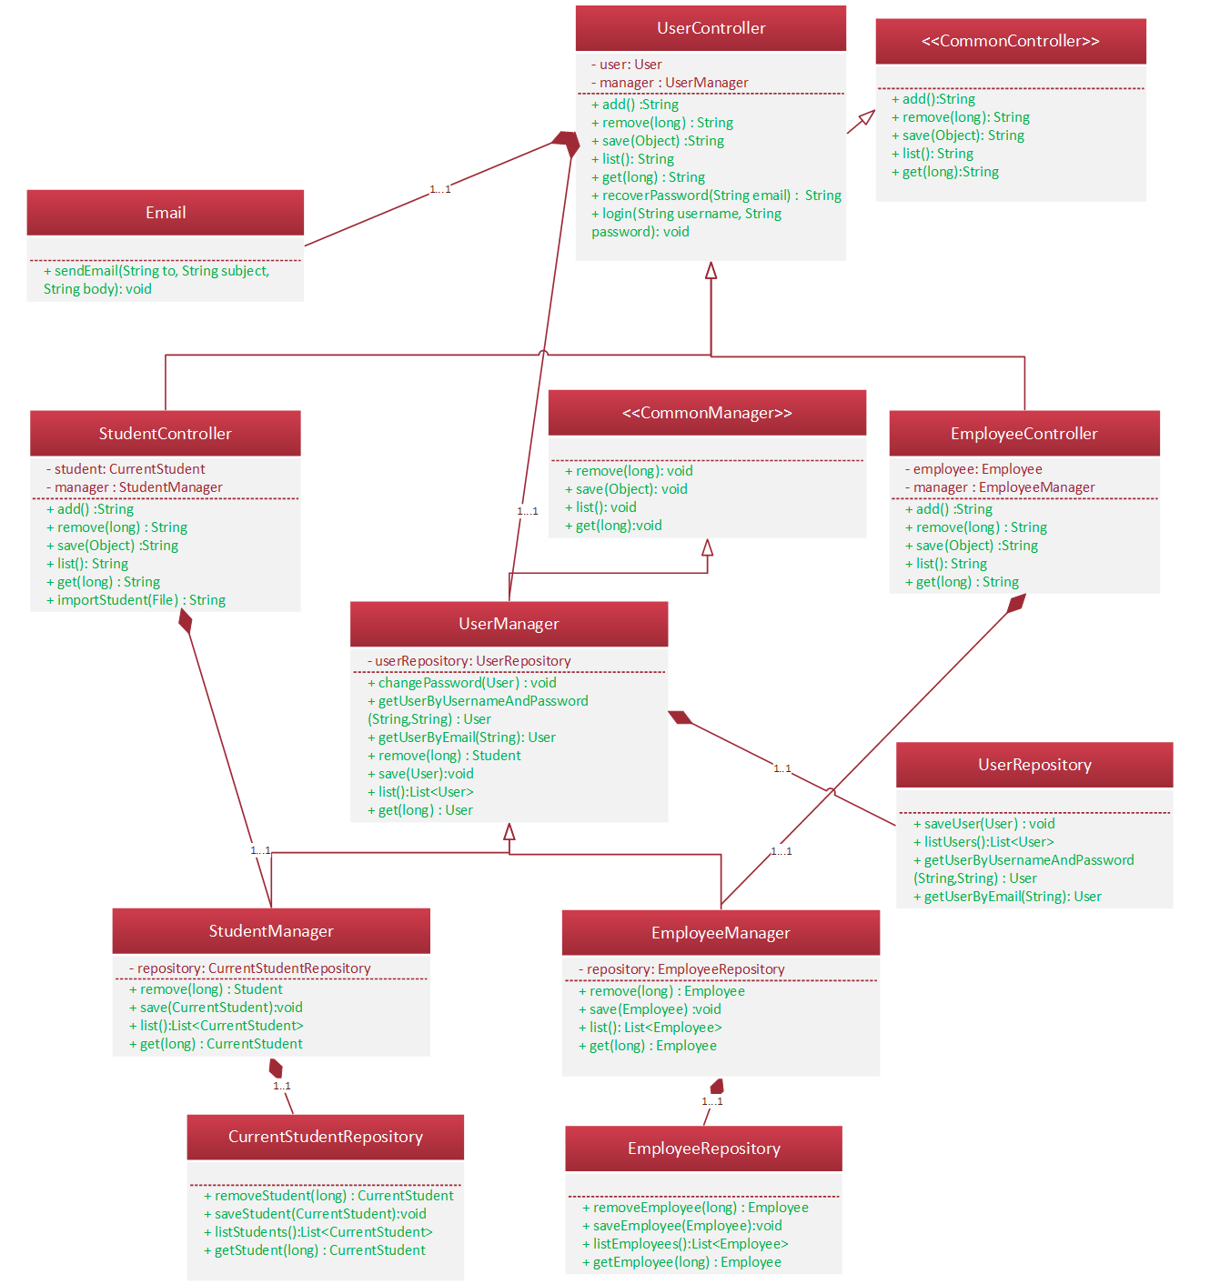
Class Diagram (Controller)

Slide 10
Class Diagram (Overview)
SmartMeeting
Model | Repository | Manager | Controller | View
Event | EventRepository | EventManager | EventController | UIEvent and UIEvents
Room | RoomRepository | RoomManager | RoomController | UIRoom and UIRooms
Speaker | SpeakerRepository | SpeakerManager | SpeakerController | UISpeaker and UISpeakers
Lecture | LectureRepository | LectureManager | LectureController | UILecture and UILectures
Attendance | AttendanceRepository | AttendanceManager | AttendanceController | UIAttendance, UIAttendances and UIValidateAttendance
Student | StudentRepository | StudentManager | StudentController | UIStudent and UIStudents
Employee | EmployeeRepository | EmployeeManager | EmployeeController | UIEmployee and UIEmployees
User | UserRepository | UserManager | UserController | UIUser, UIUsers, UIRecoverPassword and UILogin

Slide 11
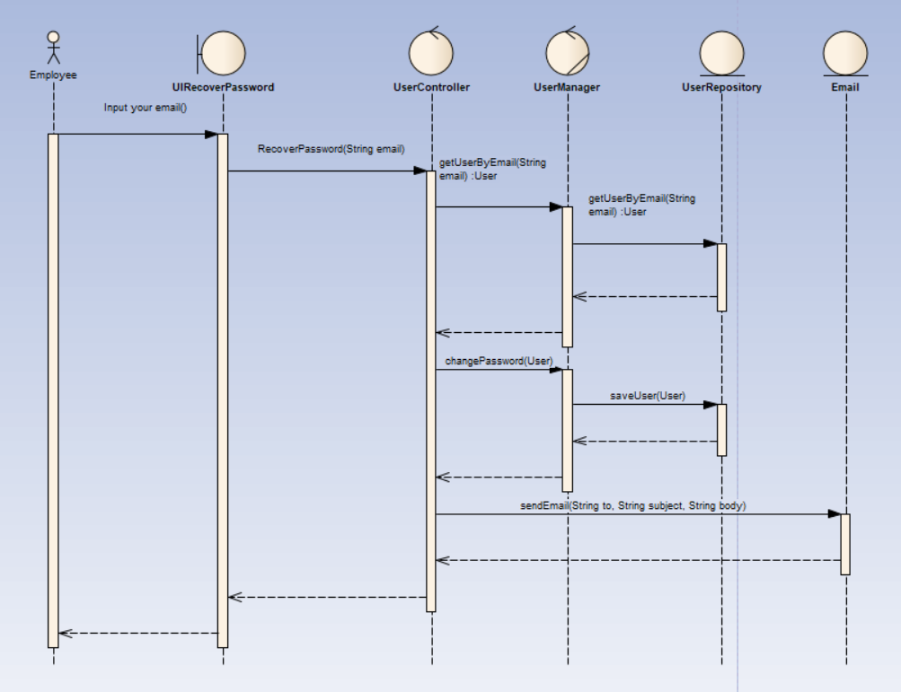
Sequence Diagram (Component)

Slide 12
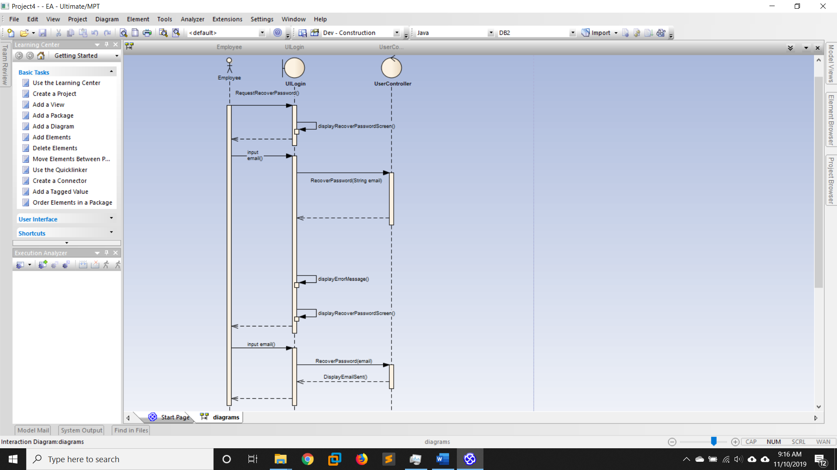
Sequence Diagram (Component)

Slide 13
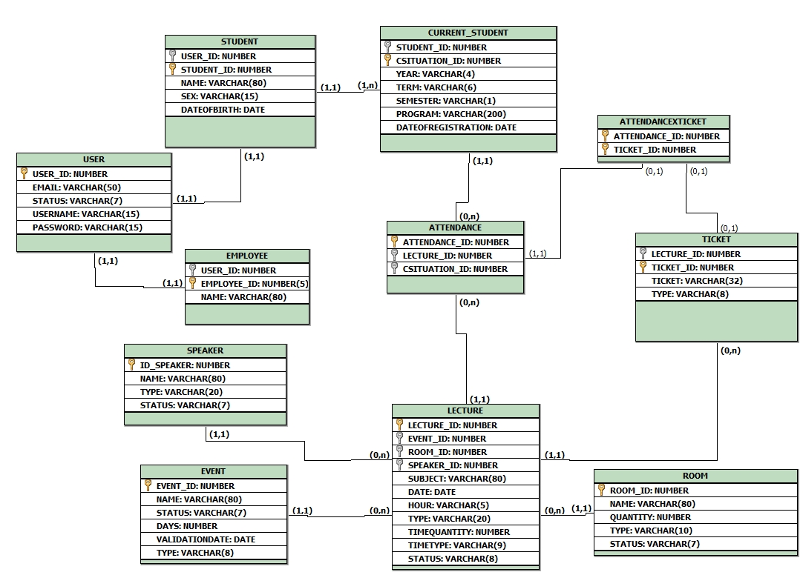
ER Diagram

Slide 14
Conclusion
Knowledge enhancement in architecture and development of distributed solutions
Time management challenge and task prioritization
Autonomy of members in performing tasks
Development and development of a solution for an underexplored niche market

Slide 15

Q & A

Slide 16

Thank you!

